Slide 1
Introduction to Kubernetes
Understanding the Basics of Container Orchestration

Slide 2
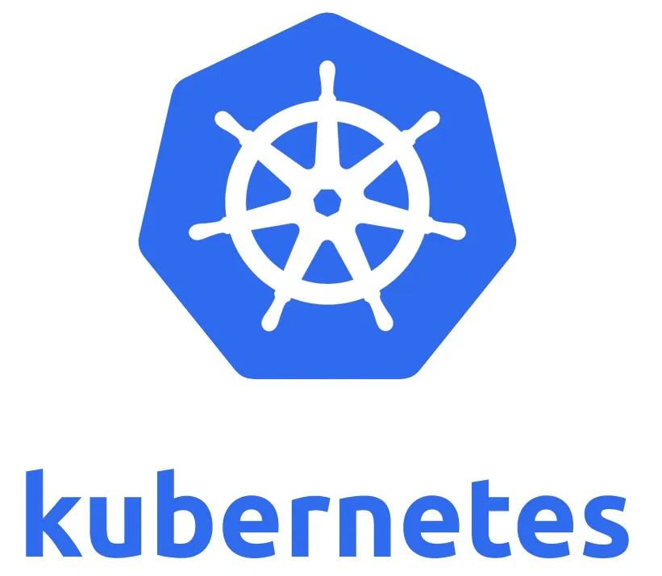
What is Kubernetes?
Kubernetes (K8s) is an open-source platform designed to automate deploying, scaling, and operating containerized applications.
Originally developed by Google, now maintained by the Cloud Native Computing Foundation (CNCF).
Helps manage clusters of containers.

Slide 3
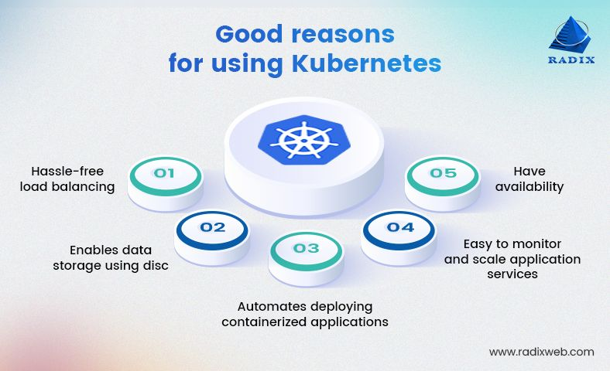
Why Use Kubernetes?
Automates container deployment and scaling.
Ensures application availability and fault tolerance.
Simplifies resource management.

Slide 4
Kubernetes Architecture
Master node and worker nodes architecture.
Control Plane: API Server, Scheduler, Controller Manager.
Worker Plane: Kubelet, Kube Proxy.
Etcd as a distributed key-value store.

Slide 5
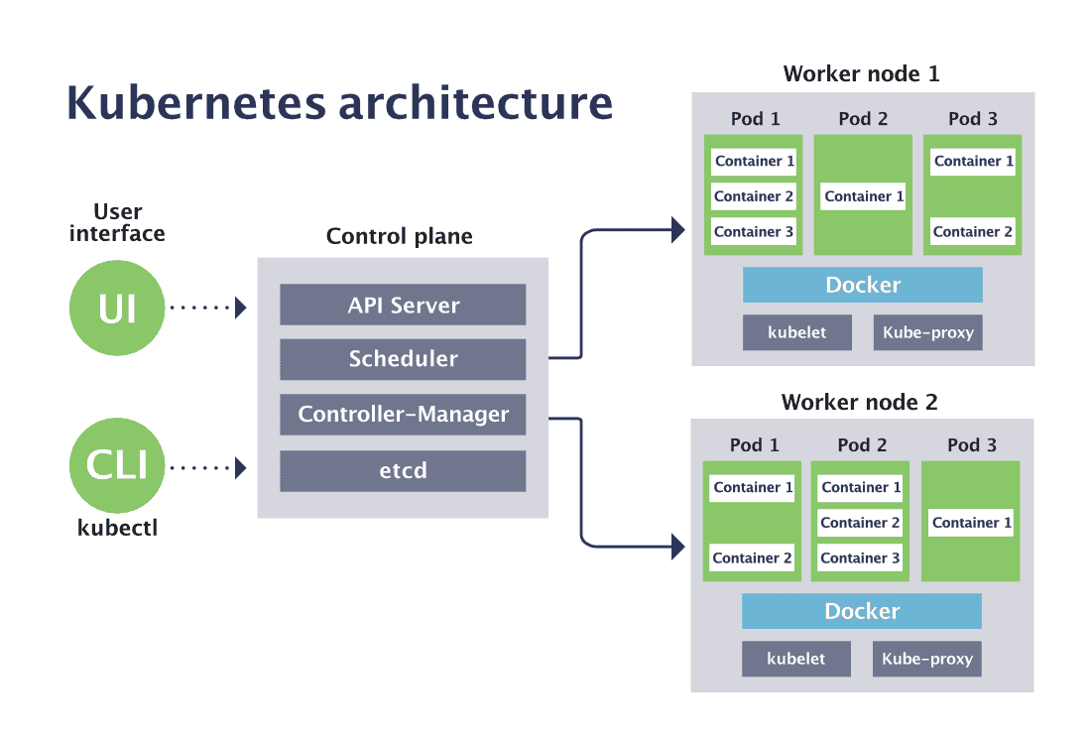

Slide 6
Architecture Details
Control Plane: Manages the cluster's overall operations through components like API Server, Scheduler, and Controller Manager.
API Server: Central communication hub for the Kubernetes cluster, handling REST API requests.
Scheduler: Assigns Pods to nodes based on resource availability and constraints.
Controller Manager: Ensures the cluster's desired state by running controllers like Node and Replication Controllers.
etcd: A distributed, highly available key-value store used by Kubernetes to store all cluster data, including configuration, state, and metadata. It ensures consistency across the cluster.
Worker Plane: Executes workloads on nodes using Kubelet (container management) and Kube Proxy (networking).
Kubelet: Manages containers on a worker node, ensuring they are running as instructed.
Kube Proxy: Handles networking, enabling communication between Pods and Services.

Slide 7
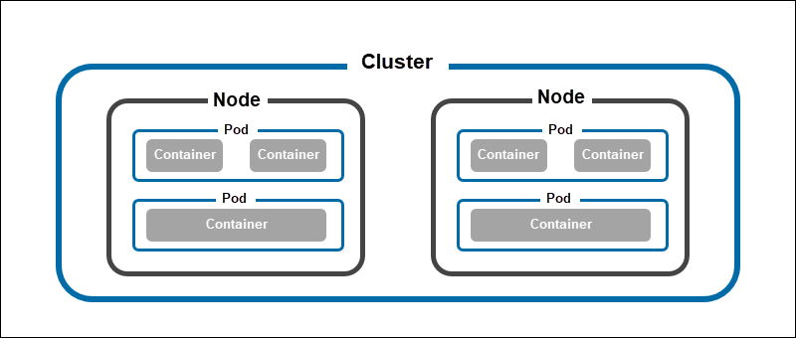
Cluster

Slide 8
How Kubernetes Works
Uses declarative configuration and desired state.
Schedules workloads on worker nodes.
Monitors application health.
Self-heals by restarting failed containers.

Slide 9
Key Kubernetes Objects
Pod: Group of containers.
Service: Exposes application as a network service.
ConfigMap: External configuration for Pods.
Ingress: HTTP and HTTPS routing.
Deployment: Manages replicas of Pods.

Slide 10
Benefits of Kubernetes
High availability.
Scalability and performance.
Portability across environments.
Cost optimization with resource management.

Slide 11
Popular Use Cases
Microservices architecture.
Batch processing and CI/CD pipelines.
Edge computing and IoT.
Hybrid and multi-cloud setups.

Slide 12
Getting Started with Kubernetes
Install Minikube or use a managed Kubernetes service (e.g., GKE, EKS, AKS).
Write configuration files in YAML.
Use kubectl for cluster management.

Slide 13
Challenges of Kubernetes
Complexity in setup and management.
Steep learning curve.
Security and monitoring concerns.
Resource overhead.

Slide 14
Conclusion
Kubernetes is a powerful tool for managing containerized applications.
Its robust features and scalability make it ideal for modern application deployment.
Embrace Kubernetes to simplify and optimize your infrastructure.

